Slide 1
Hello There!

Slide 2
How are you today?
I’m not so good
I’m good

Slide 3
What's the weather like today?

Slide 4
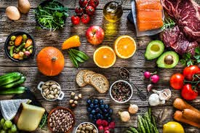
Food

Slide 5
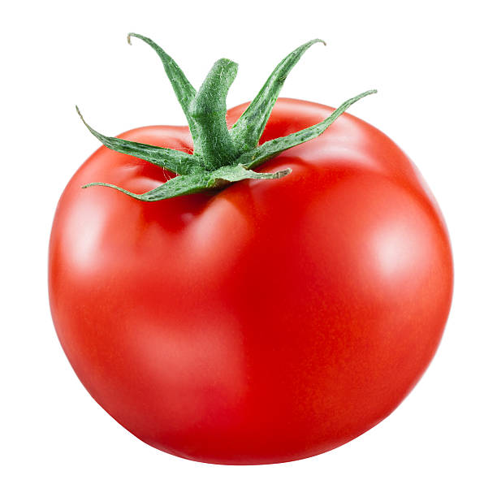
Tomato

Slide 6
Potato

Slide 7
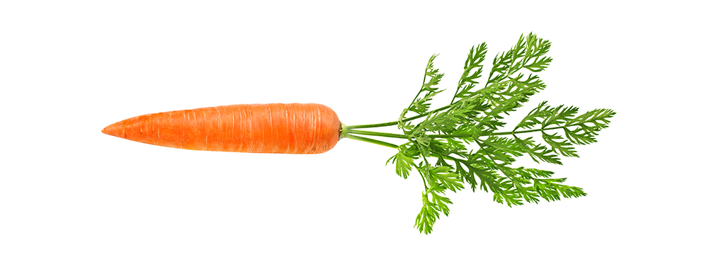
Carrot

Slide 8
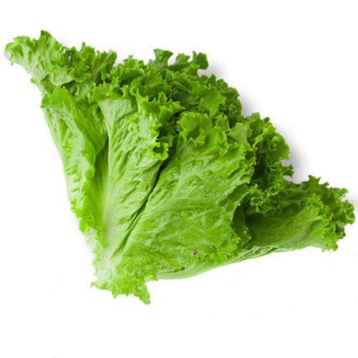
Lettuce

Slide 9
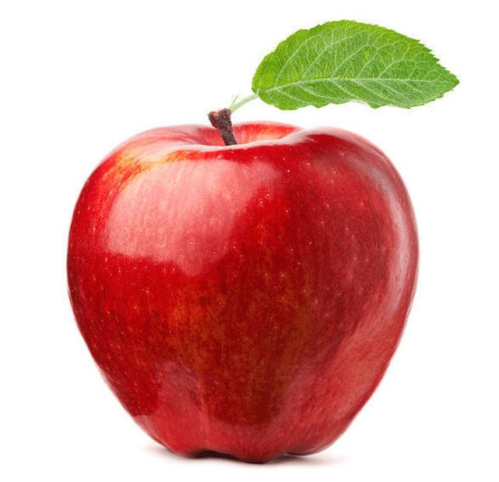
Apple

Slide 10
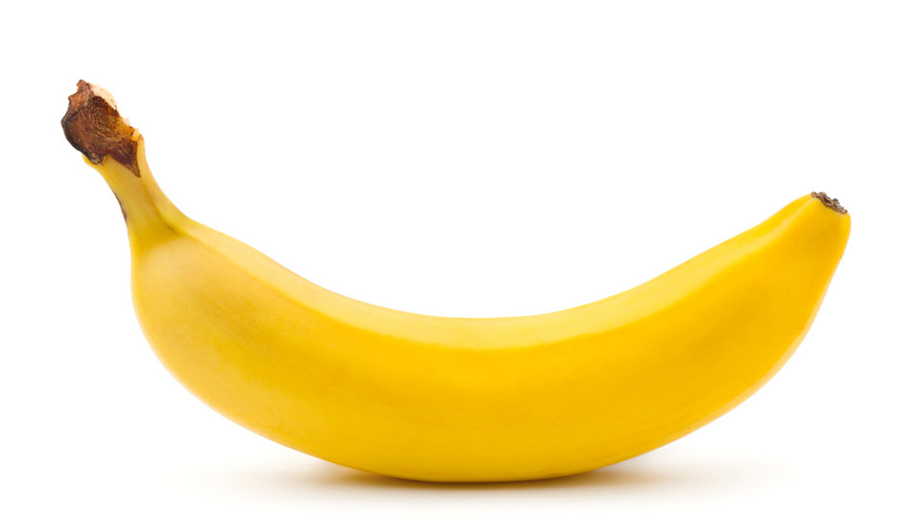
Banana

Slide 11
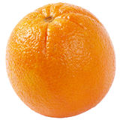
Orange

Slide 12
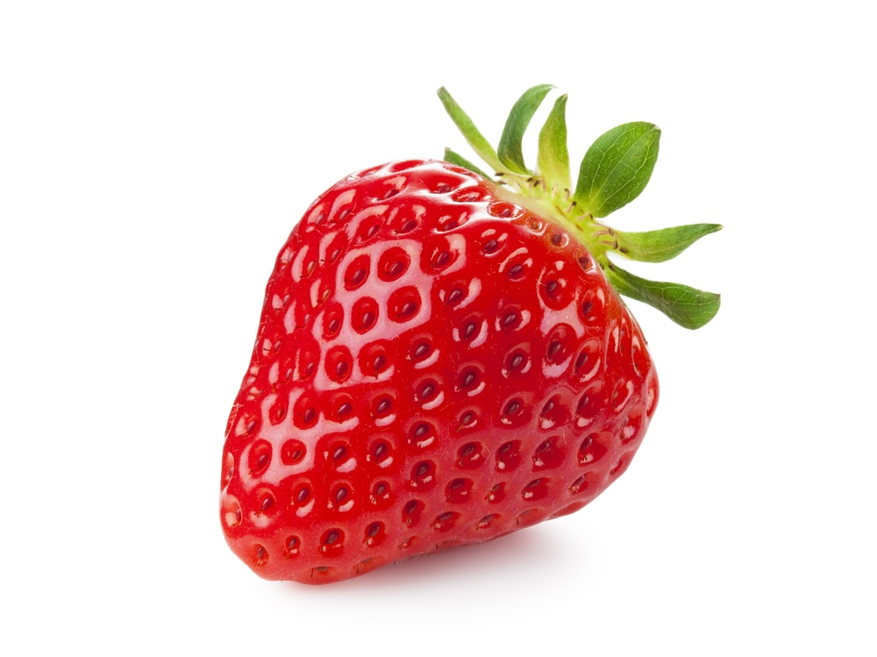
Strawberry

Slide 13
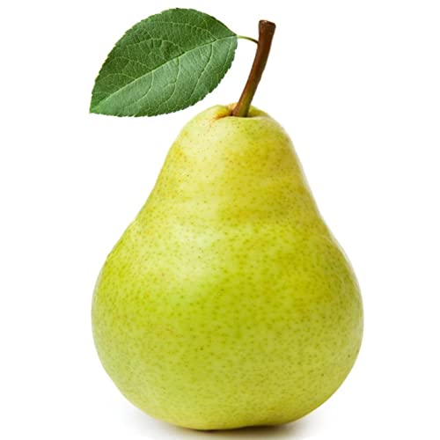
Pear

Slide 14
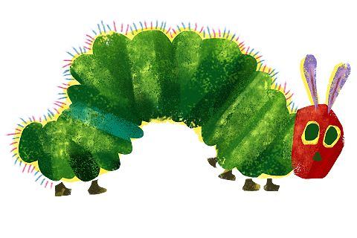
Story time!

Slide 15
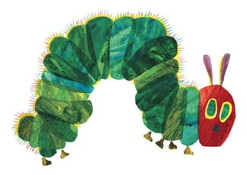
The very hungry Caterpillar
I’m hungry!

Slide 16
On Monday, the caterpillar ate through one apple. But he was still hungry
I’m still hungry.

Slide 17
On Tuesday, he ate through two pears, but he was still hungry
I’m hungry

Slide 18
On Wednesday he ate through three oranges, but he was still hungry.
I’m hungry

Slide 19
On Thursday, he ate through four strawberries. But he was still hungry
I’m still hungry!

Slide 20
On Friday he ate through five oranges, but he was still hungry.
I’m still hungry!

Slide 21
On Saturday he ate through…..
That night he had stomach-ache!

Slide 22
The next day was Sunday again. The caterpillar ate through one nice green leaf, and after that he felt much better.

Slide 23
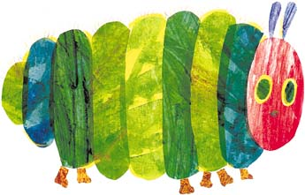
Now he wasn’t hungry anymore- and he wasn’t a little caterpillar any more.
He was a big, fat caterpillar.

Slide 24
He built a small house, called a cocoon, around himself. He stayed inside for more than two weeks.
Then he nibbled a hole in the cocoon, pushed his way out ………

Slide 25
He was a beautiful butterfly!

Slide 26
GOOD BYE!!

