Slide 1
Hello!

Slide 2
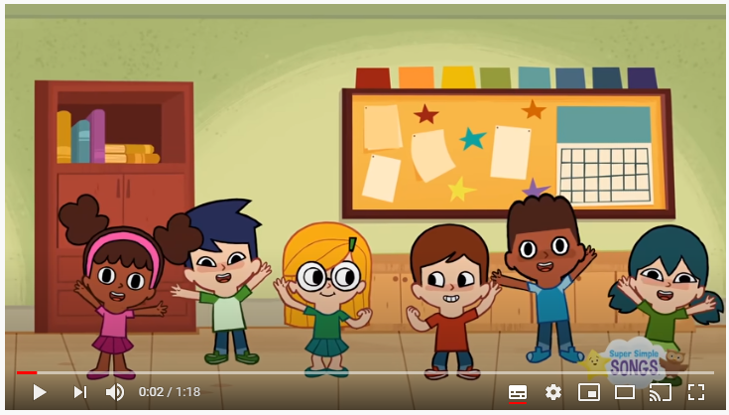
How are you today?
https://www.youtube.com/watch?v=tVlcKp3bWH8

Slide 3
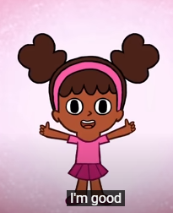
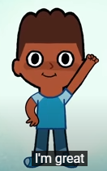
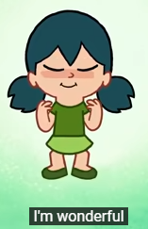
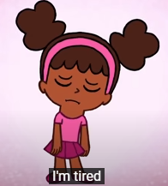
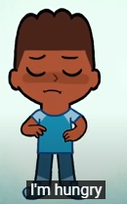
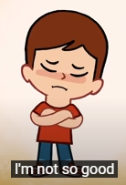
How are you?

Slide 4
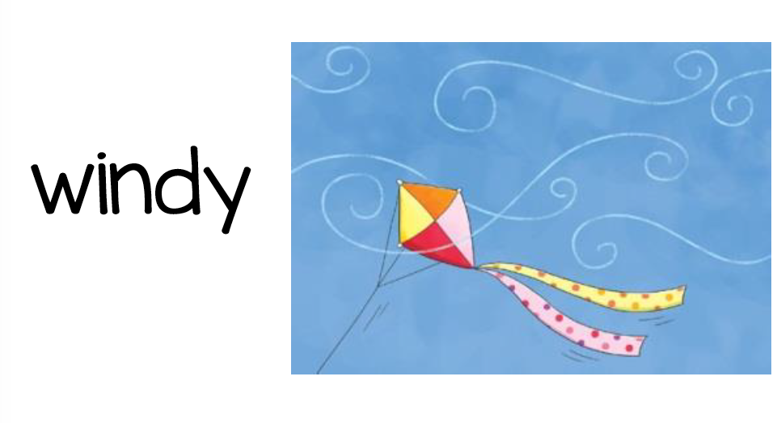
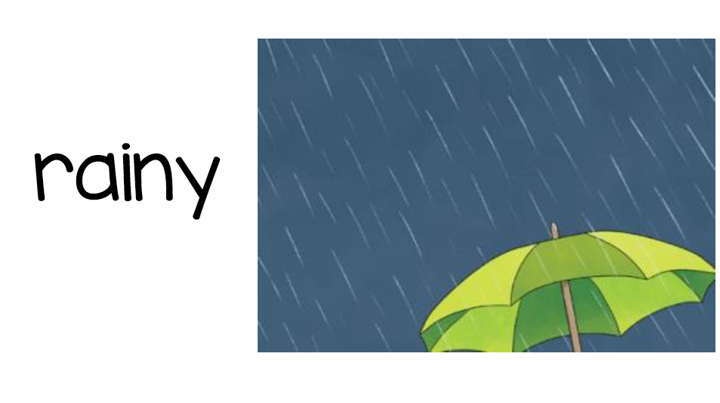
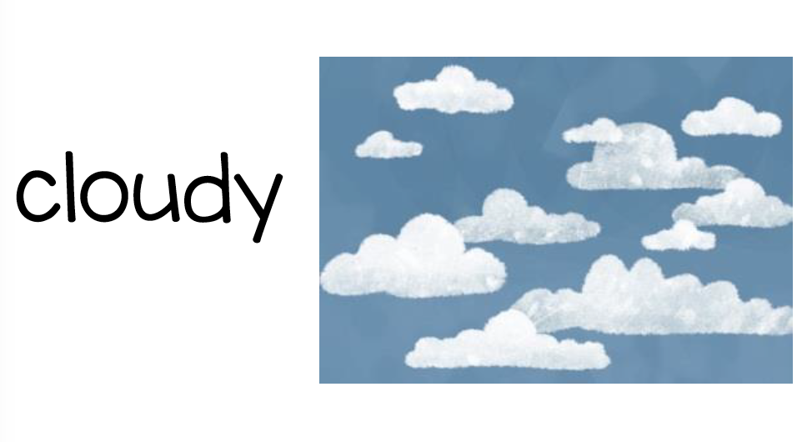
What’s the weather like today?

Slide 5
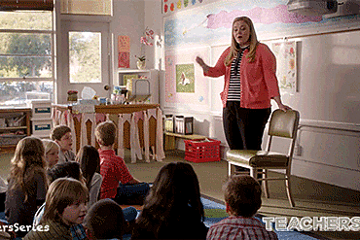
Teacher

Slide 6
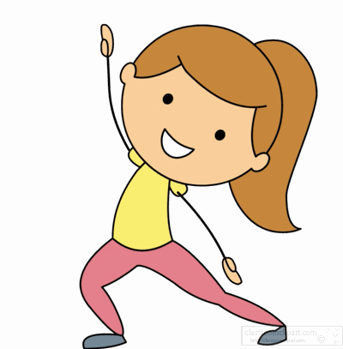
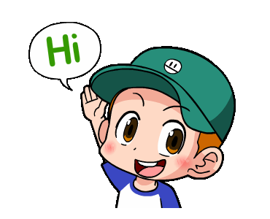
Girl
Boy

Slide 7
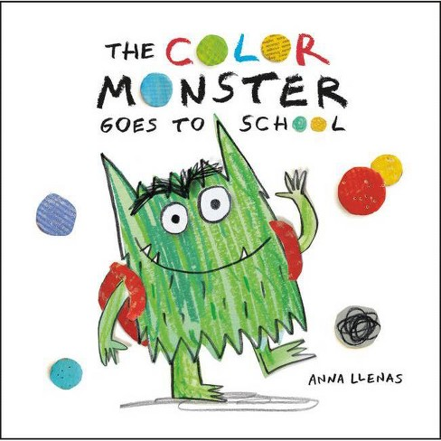
Story: The color Monster
A
b
V
A
a
a
N
F
a
A
N
A
a
f
A
a
a
A
A
A
V
F
Write the number of uppercases:
a
A
b
A
V

Slide 8
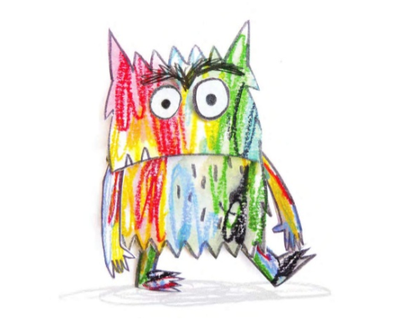
Hello! I’m the color monster and my colors are mixed up
Red
Yellow
Blue
Black
Green

Slide 9
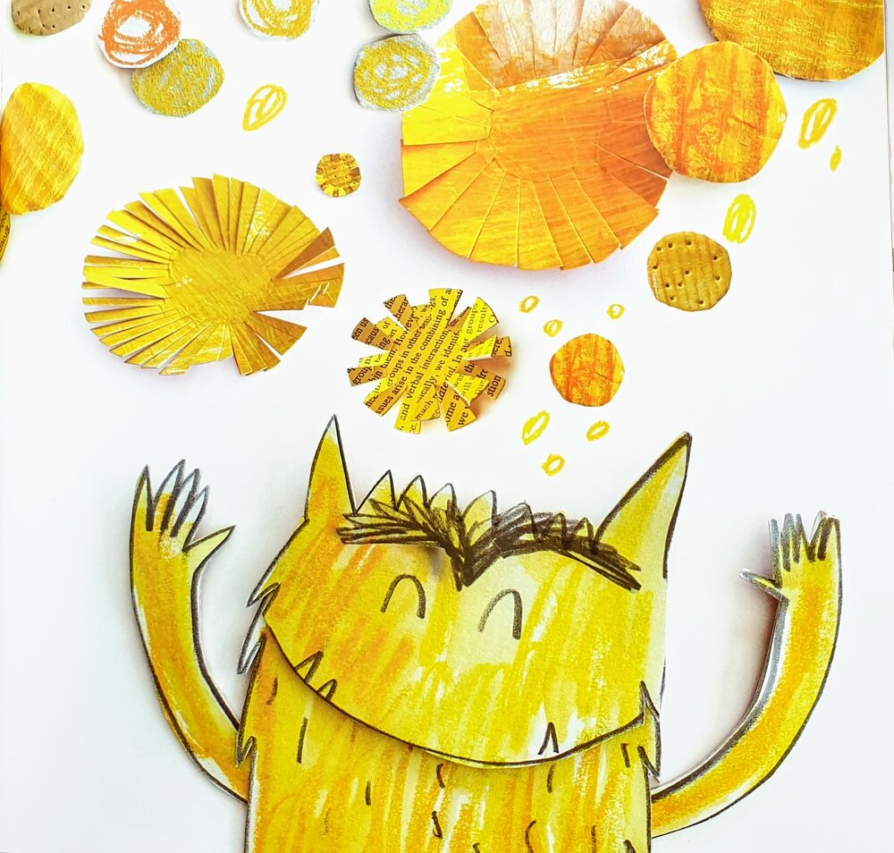
When He is happy he shines yellow…
…like the sun and stars

Slide 10
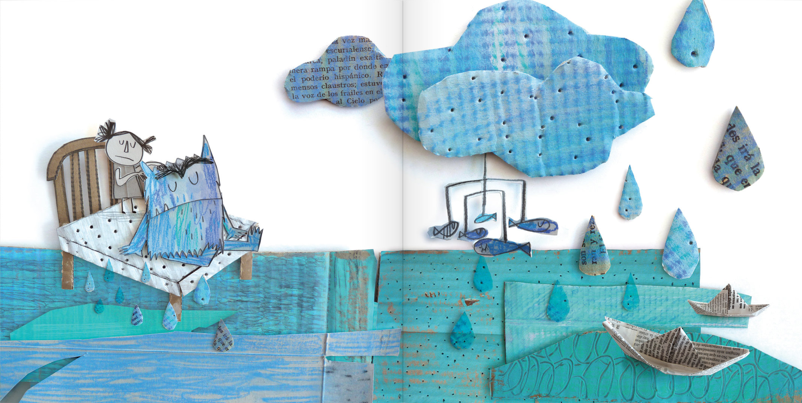
When he is sad… he is blue like a rainy day

Slide 11
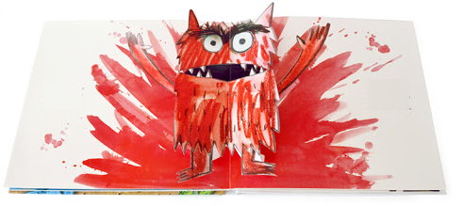
When he feels angry he is red. He wants to shout.

Slide 12
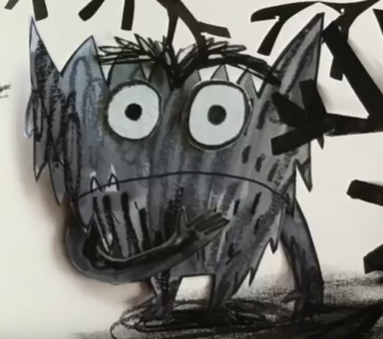
When he is scared, He is black like a shadow

Slide 13
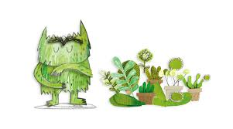
When he is calm and relaxed he is green

Slide 14
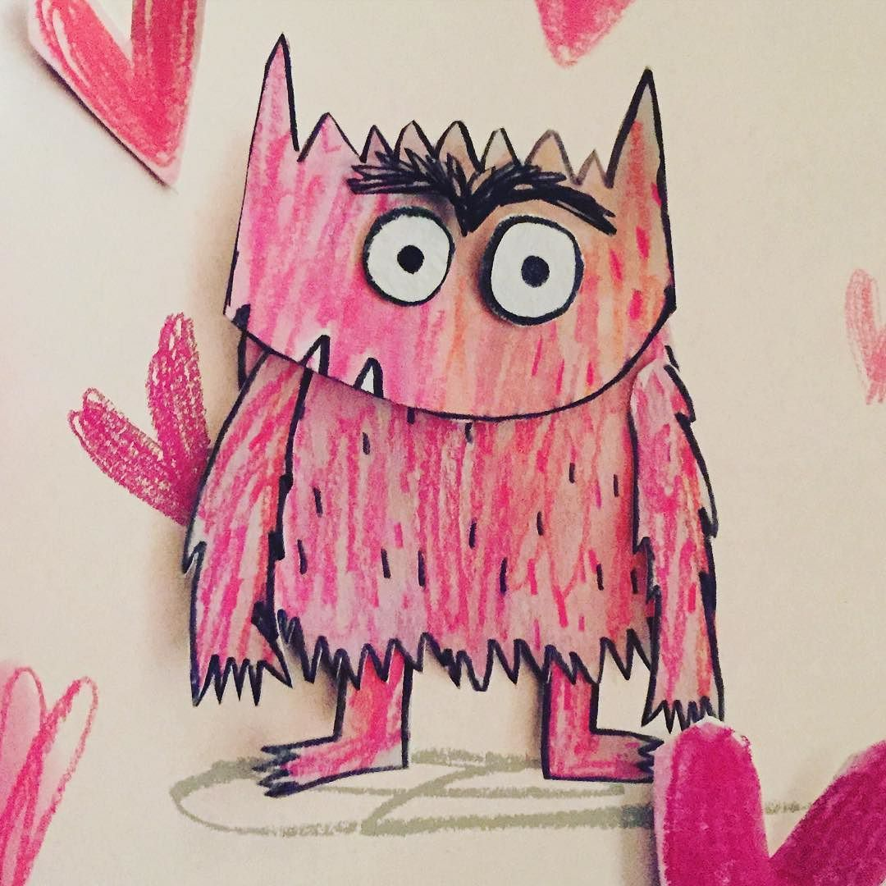
But… look… a new color

Slide 15
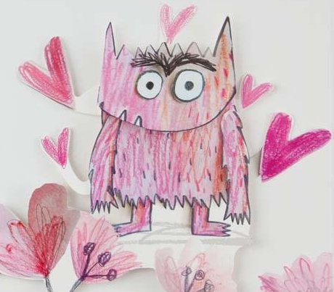
He is in love. He is color pink

Slide 16
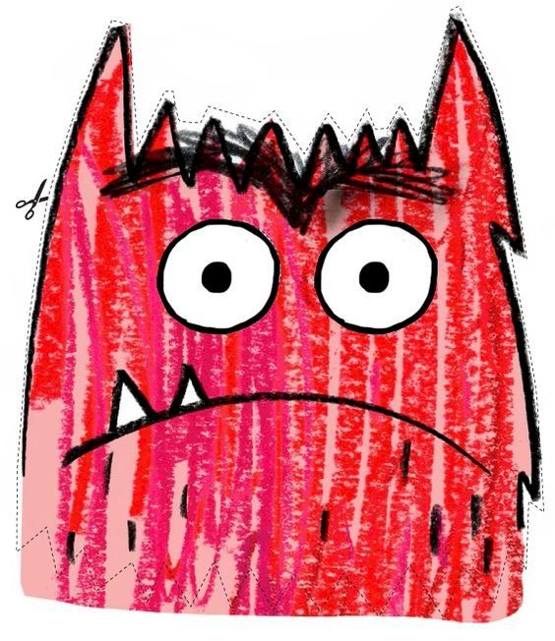
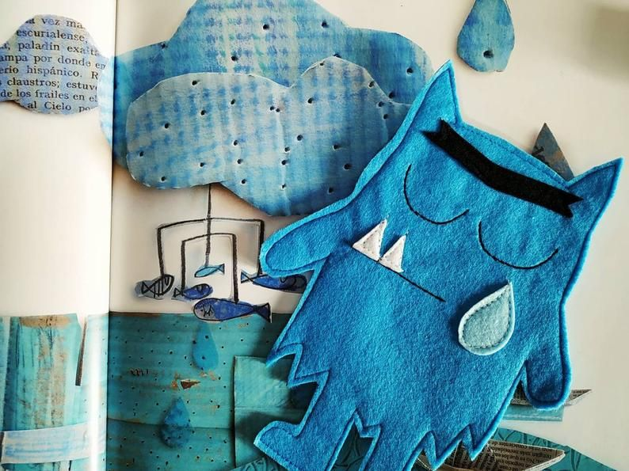
Which Color can you see?

Slide 17
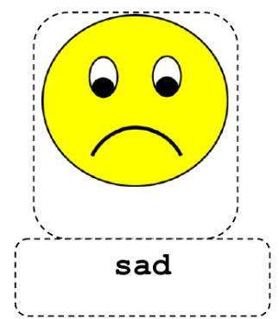
Which emotions can you see?
Angry
scared

Slide 18
Emotions:
Angry
scared

Slide 19
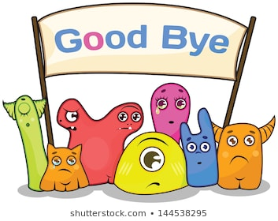
Good bye !!

