Slide 1
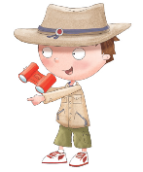
Unit 4
My favourite thing
Hello there!

Slide 2
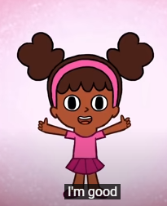
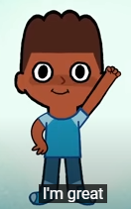
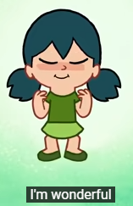
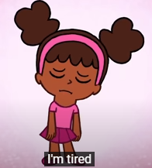
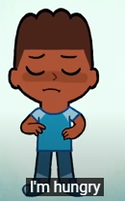
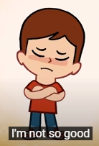
How are you today?

Slide 3
What's the weather like today?

Slide 4
https://www.youtube.com/watch?v=98pjI8t9u-0

Slide 5
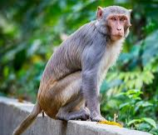
Monkey

Slide 6
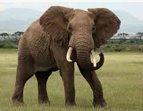
Elephant

Slide 7
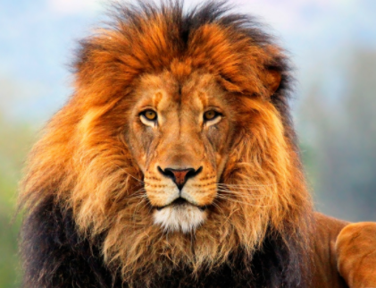
Lion

Slide 8
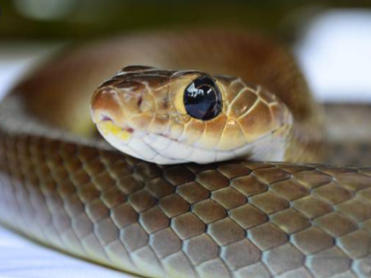
Snake

Slide 9
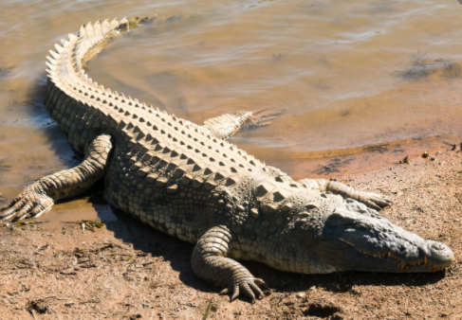
Crocodile

Slide 10
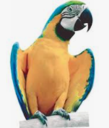
Parrot

Slide 11
1
2
3
4
5
6
7
8
9
10
11
12

Slide 12
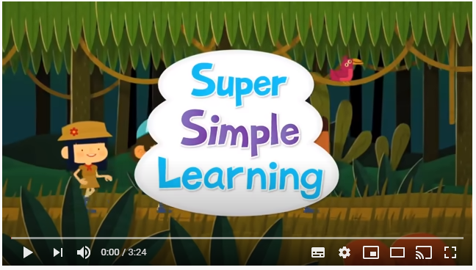
Let’s sing
https://www.youtube.com/watch?v=GoSq-yZcJ-4

Slide 13
Point to

Slide 14
Point to

Slide 15
Point to

Slide 16
Point to

Slide 17
Point to

Slide 18
Point to

Slide 19
Good Bye

