Slide 1


Toys

Slide 2
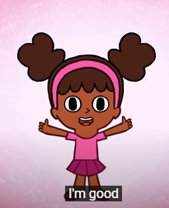

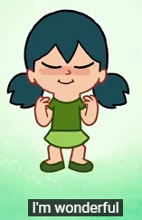
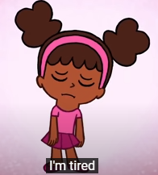
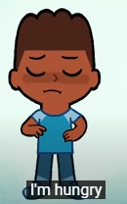
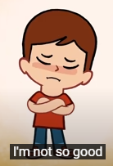
How are you today?

Slide 3




What’s the weather like today?

Slide 4
Let’s play with my toys

Slide 5
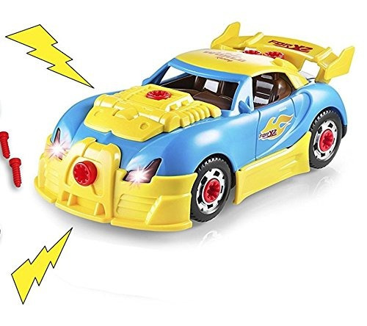
Car

Slide 6
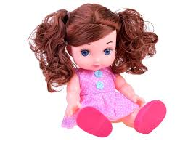
Doll

Slide 7
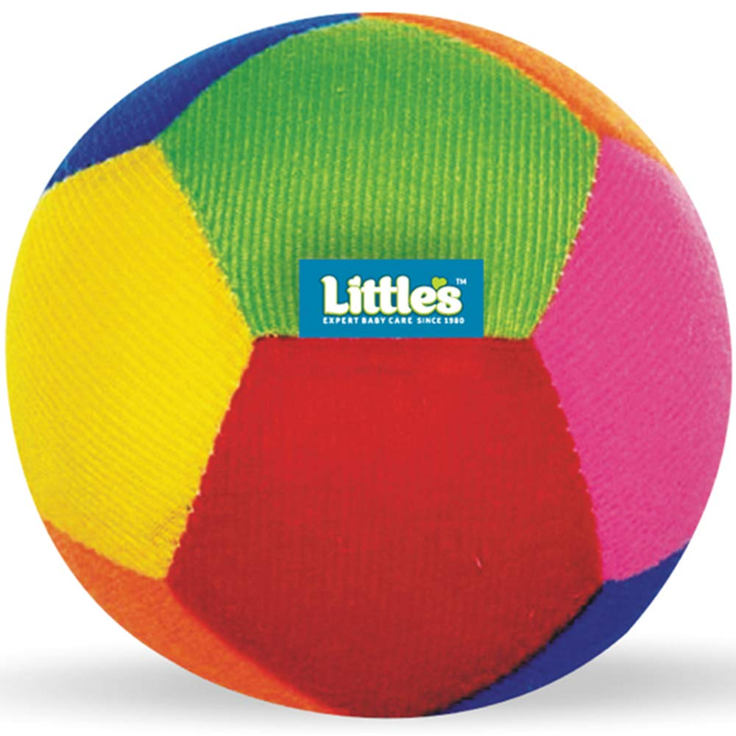
Ball

Slide 8
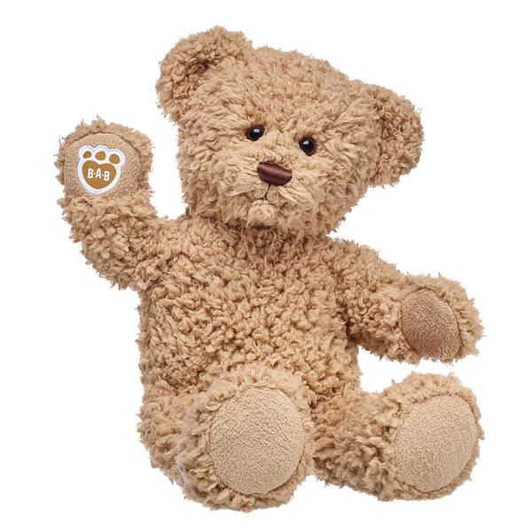
Teddy Bear

Slide 9
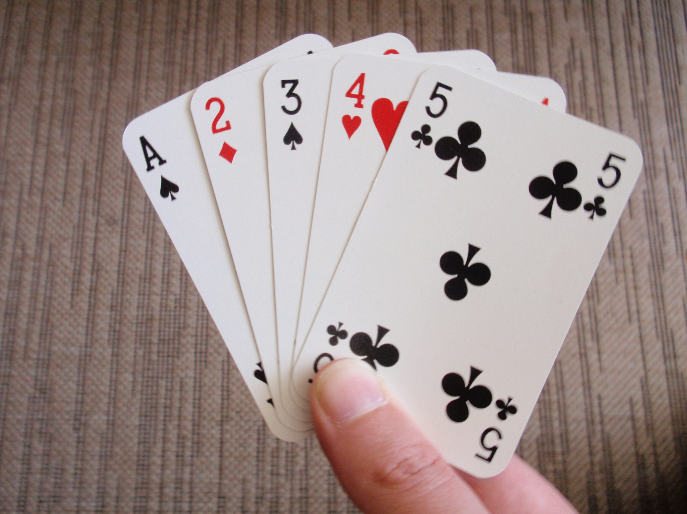
Cards

Slide 10
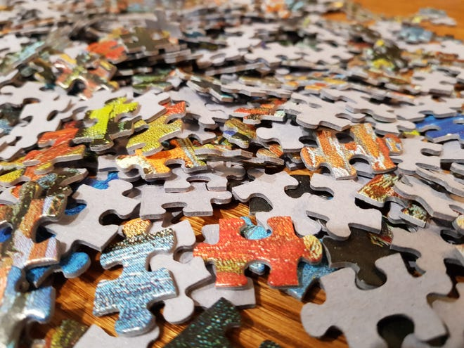
Jigsaw

Slide 11
What is your favourite toy?

Slide 12
Point to…

Slide 13
Point to

Slide 14
Good Bye!

