Slide 1
Professions

Slide 2
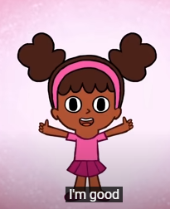
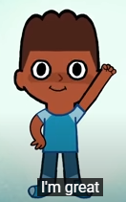
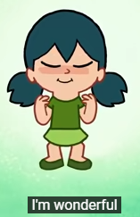
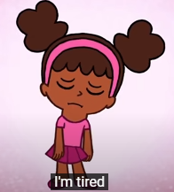
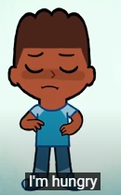
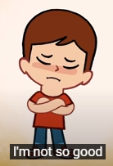
How are you today?

Slide 3
What’s the weather like today?

Slide 4
What is your favourite?

Slide 5
Teacher

Slide 6
Doctor

Slide 7
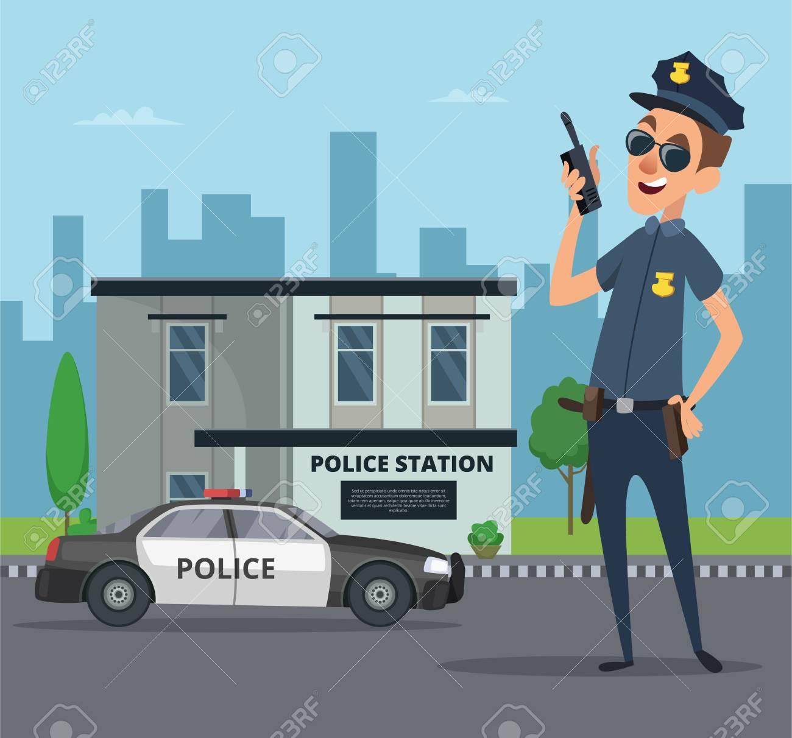
Policeman

Slide 8
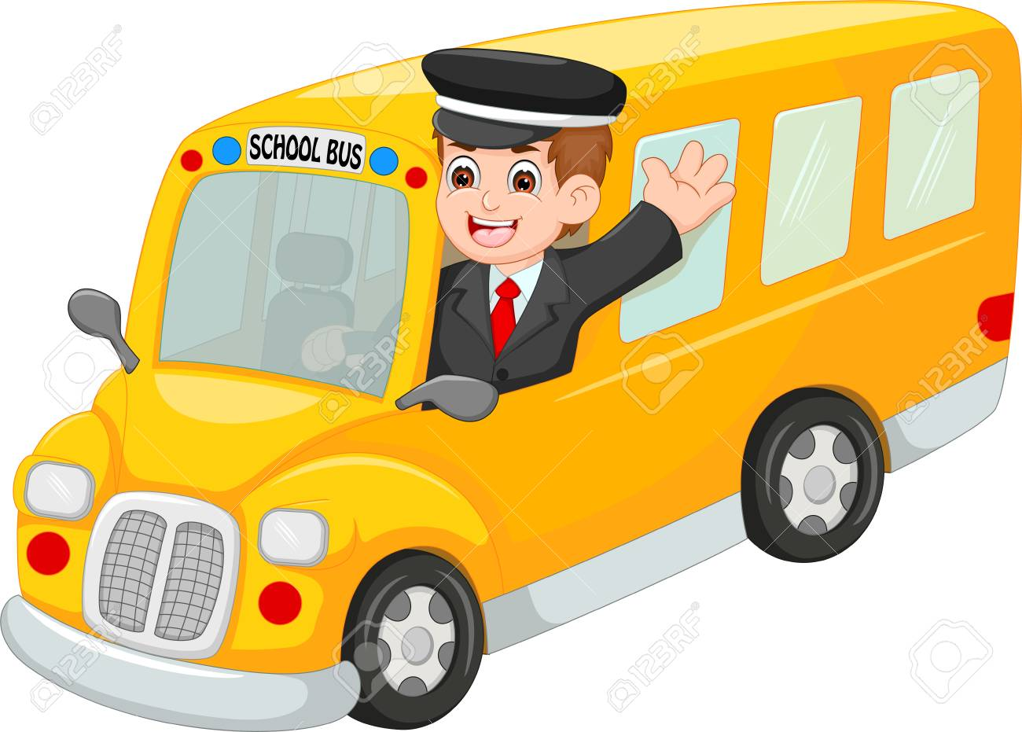
Driver

Slide 9
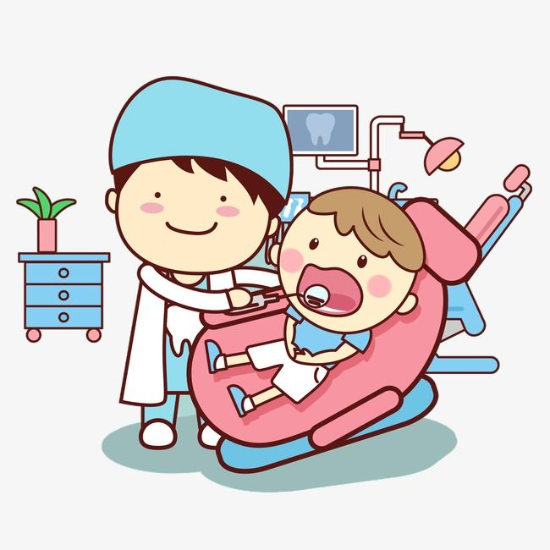
Dentist

Slide 10
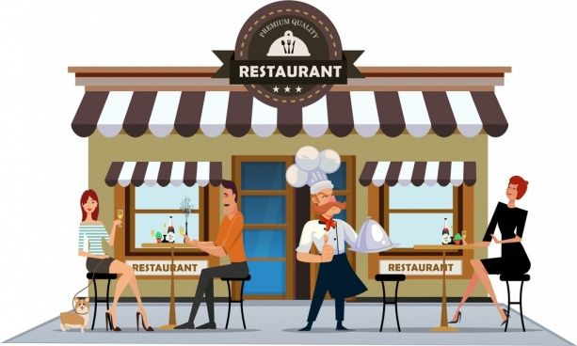
waiter

Slide 11
Point to…

Slide 12
Point to…

Slide 13
Match the professions to the place in which they work

Slide 14
Good Bye!

