Slide 1
Hello Class

Slide 2
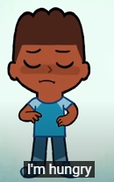
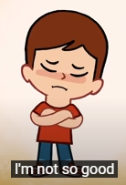
How are you?

Slide 3
What’s the weather like today?

Slide 4
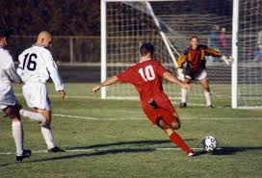
Let’s talk about football

Slide 5
Listen to and watch the video of this song
https://learnenglishkids.britishcouncil.org/songs/were-going-win

Slide 6
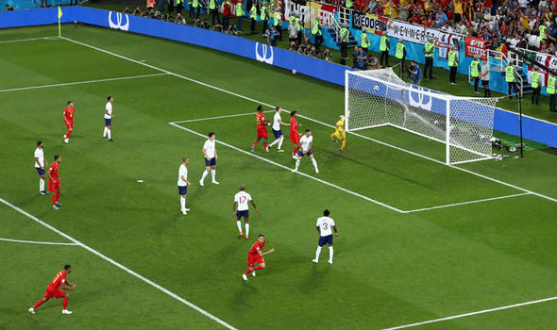
Football match

Slide 7
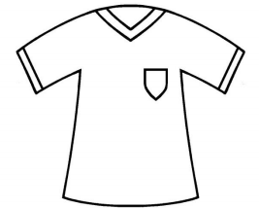
SHIRT

Slide 8
SHORT

Slide 9
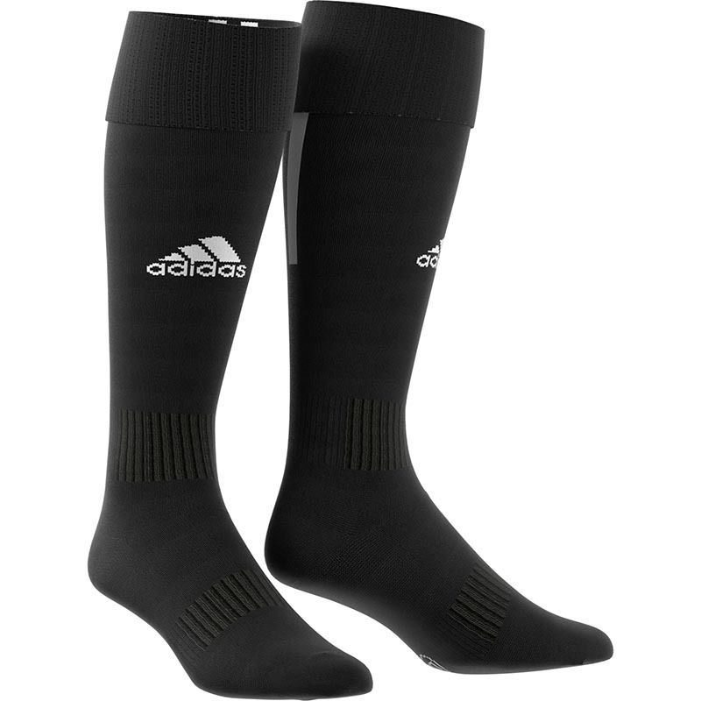
SOCKS

Slide 10
Football boots

Slide 11
BALL

Slide 12
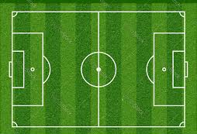
FIELD

Slide 13
Point to…

Slide 14
Point to …

Slide 15
Point to…

Slide 16
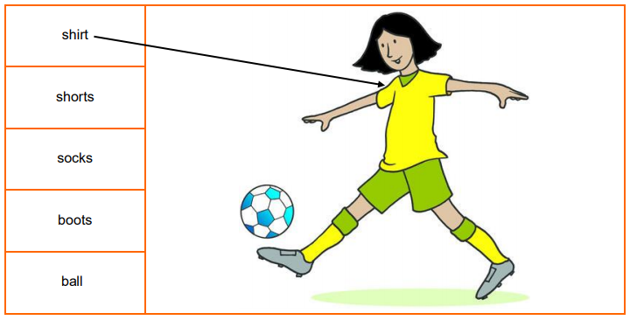
Draw a line from the words to the picture to label the football kit.

Slide 17
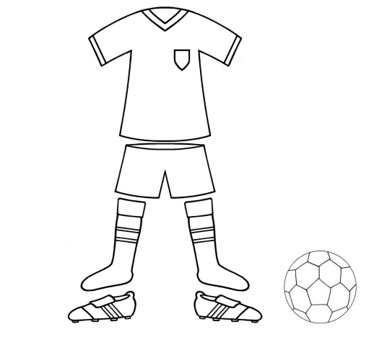
Design a football kit for your dream team

Slide 18
Good bye!

