Slide 1
Hello Class!

Slide 2
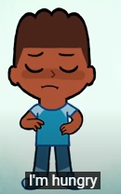
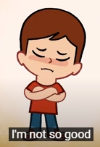
How are you?

Slide 3
What’s the weather like today?

Slide 4
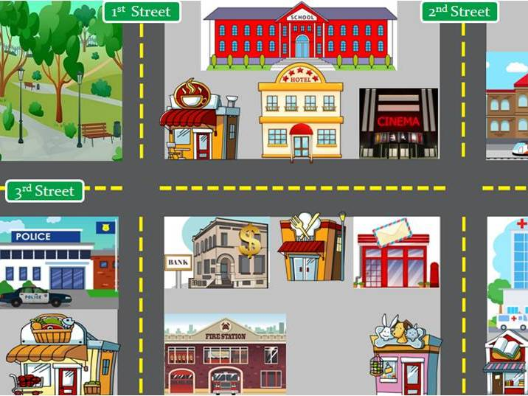
1.
Places in the city
https://www.youtube.com/watch?v=dCIwO1flbAg

Slide 5
Doctor
Nurse

Slide 6
Vet

Slide 7
CHEF

Slide 8
Police MAN

Slide 9
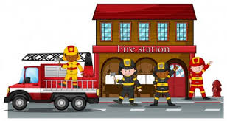
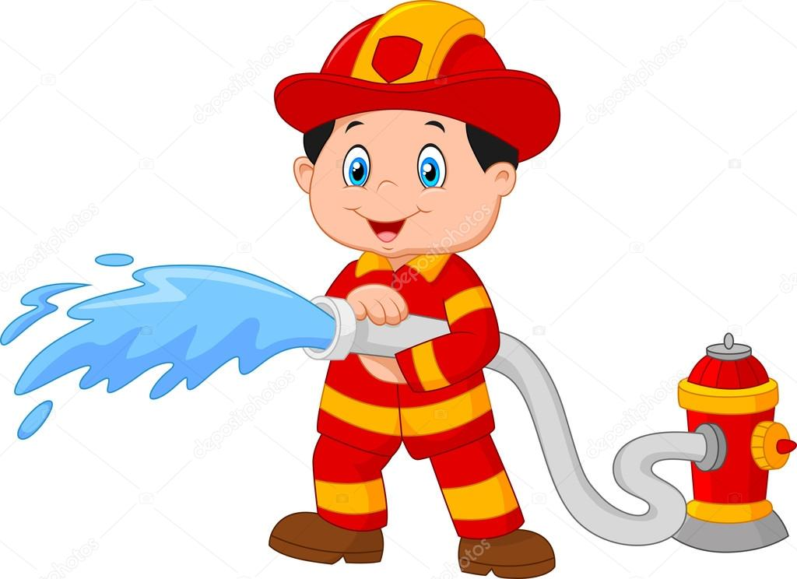
Fire fighter

Slide 10
Zookeeper

Slide 11
Professions
Doctor
Nurse
Vet
Chef
Police man
Firefighter
zookeeper

Slide 12
Point to…

Slide 13
Point to…

Slide 14
Point to…

Slide 15
Good Bye!

