Slide 1
Hello Class!

Slide 2
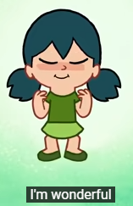
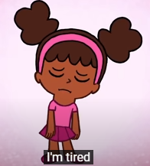
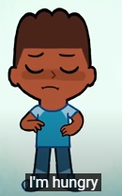
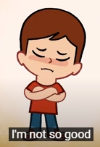
How are you?

Slide 3
What’s the weather like today?

Slide 4
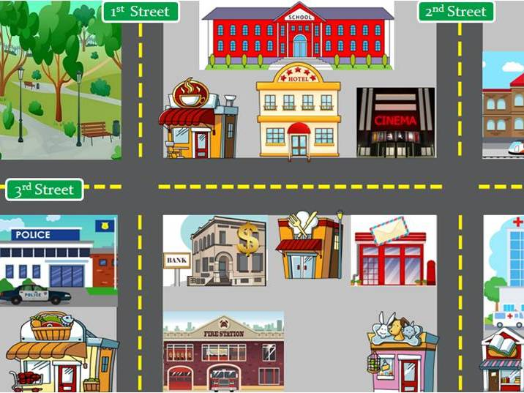
1.
Places in the city

Slide 5
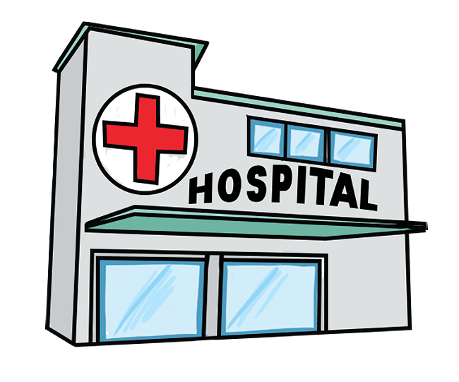
Hospital

Slide 6
Veterinary hospital

Slide 7
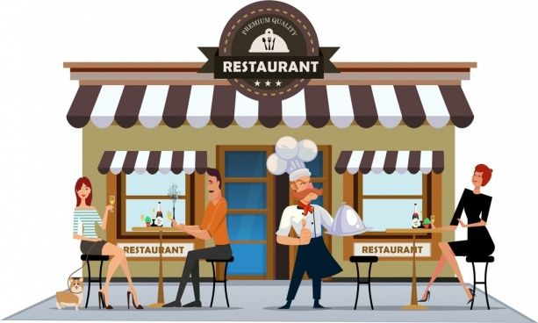
Restaurant

Slide 8
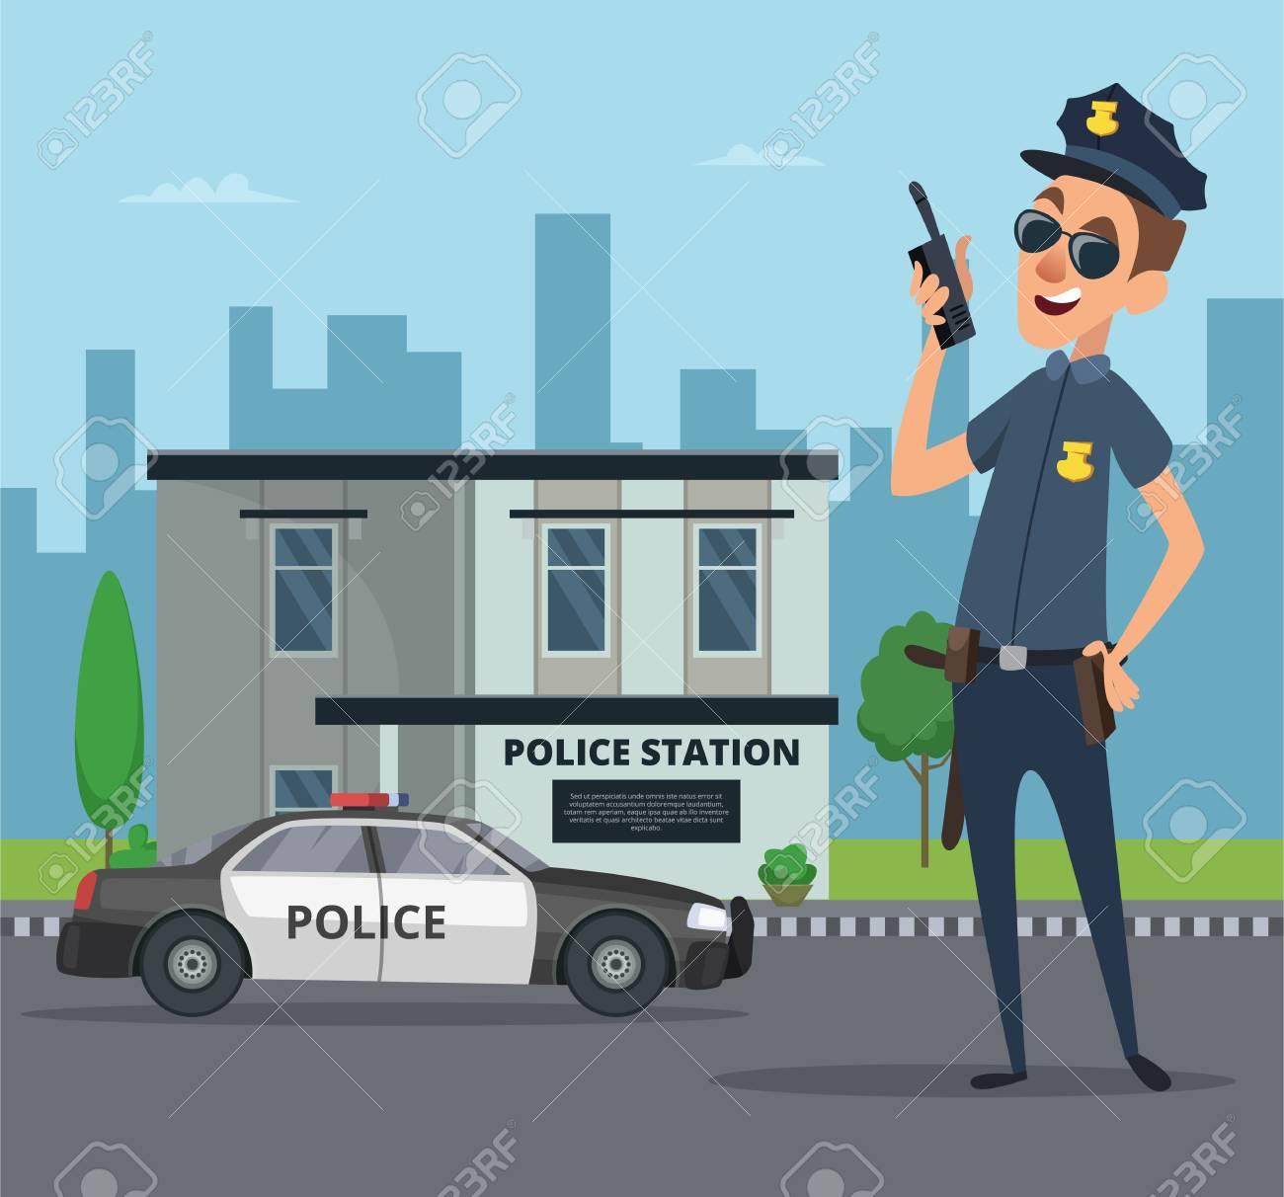
Police Station

Slide 9
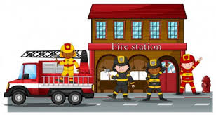
Fire Station

Slide 10
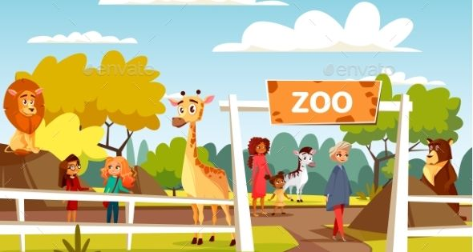
Zoo

Slide 11
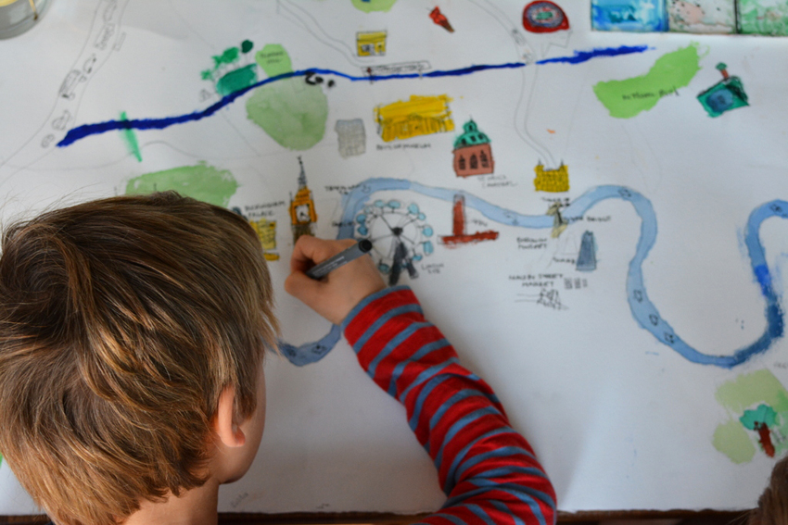
Draw your city.

Slide 12
Point to…

Slide 13
Point to…

Slide 14
Point to…

Slide 15
Good Bye!

