Slide 1
Hello students!

Slide 2
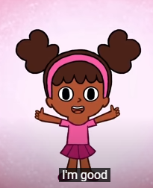
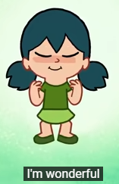
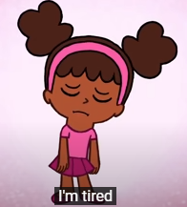
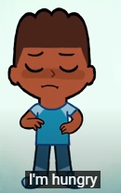
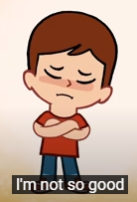
How are you?

Slide 3
What’s the weather like today?

Slide 4
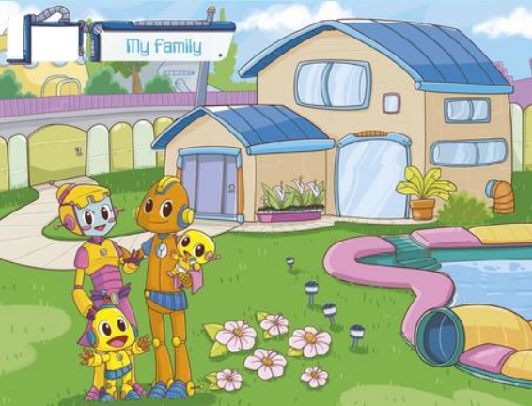

Slide 5
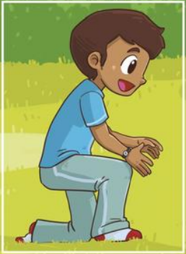
Daddy

Slide 6
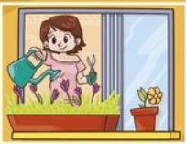
Mommy

Slide 7
Baby

Slide 8
Sister

Slide 9
Brother

Slide 10
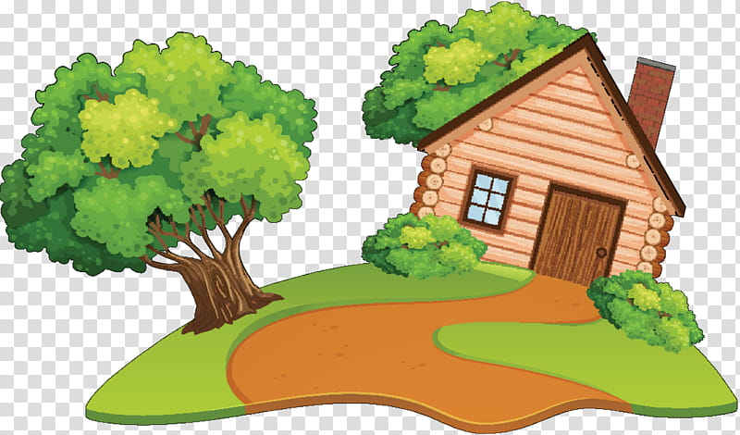
House

Slide 11
Garden

Slide 12
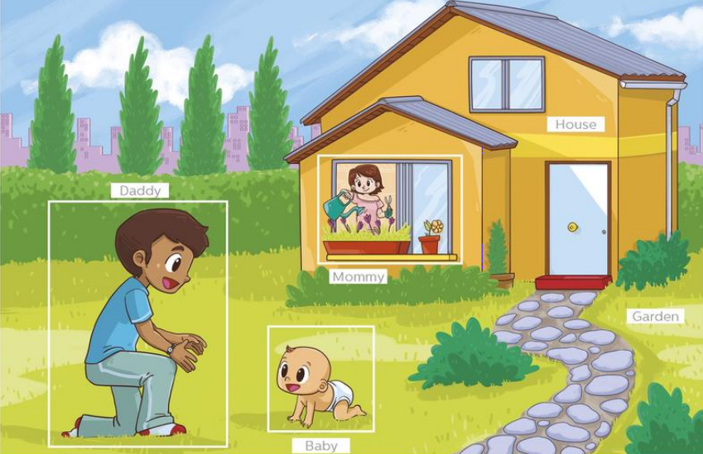
Where is mommy?
Mommy is in the house!

Slide 13
Where is daddy?
He is in the garden!

Slide 14
Where is the baby?
The baby is in the garden!

Slide 15
Point to the house

Slide 16
Point to the garden

Slide 17
Draw your family and your house

Slide 18
Good Bye!

