Slide 1
Hello students!

Slide 2
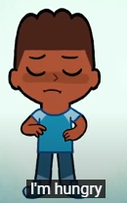
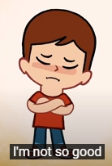
How are you?

Slide 3
What’s the weather like today?

Slide 4
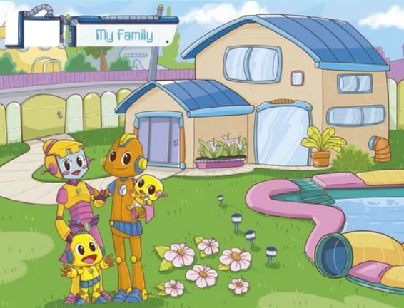

Slide 5
Mommy

Slide 6
Daddy

Slide 7
Baby

Slide 8
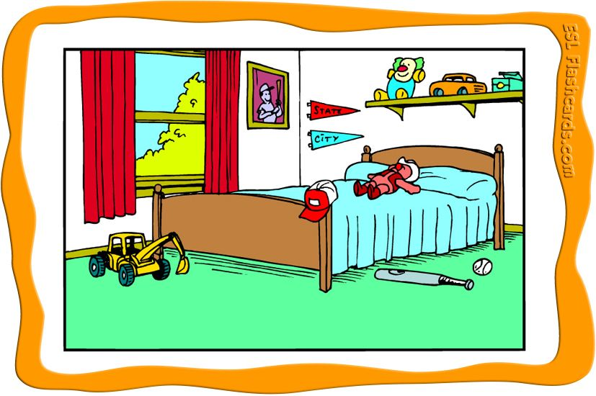
Bedroom

Slide 9
Living room

Slide 10
Bathroom

Slide 11
Kitchen

Slide 12
Where is mommy?
Mommy is in the bedroom!

Slide 13
Where is daddy?
Daddy is in the kitchen!

Slide 14
Where is the baby?
The baby is in the living room!

Slide 15
Draw and color your house

Slide 16
Good Bye!

