Slide 1
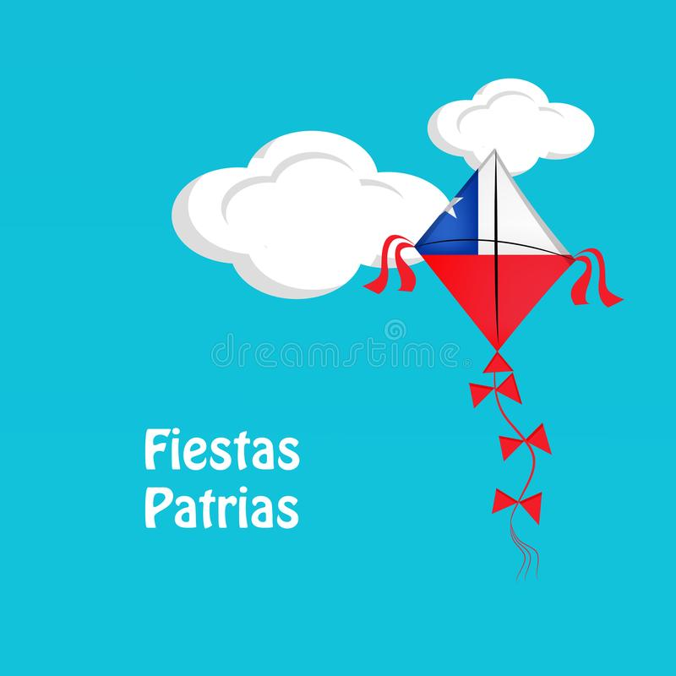
Fiestas Patrias Celebration.

Slide 2
Chilean Flag

Slide 3
Blue
White
Red

Slide 4
White Star

Slide 5
Chile

Slide 6
Cueca

Slide 7
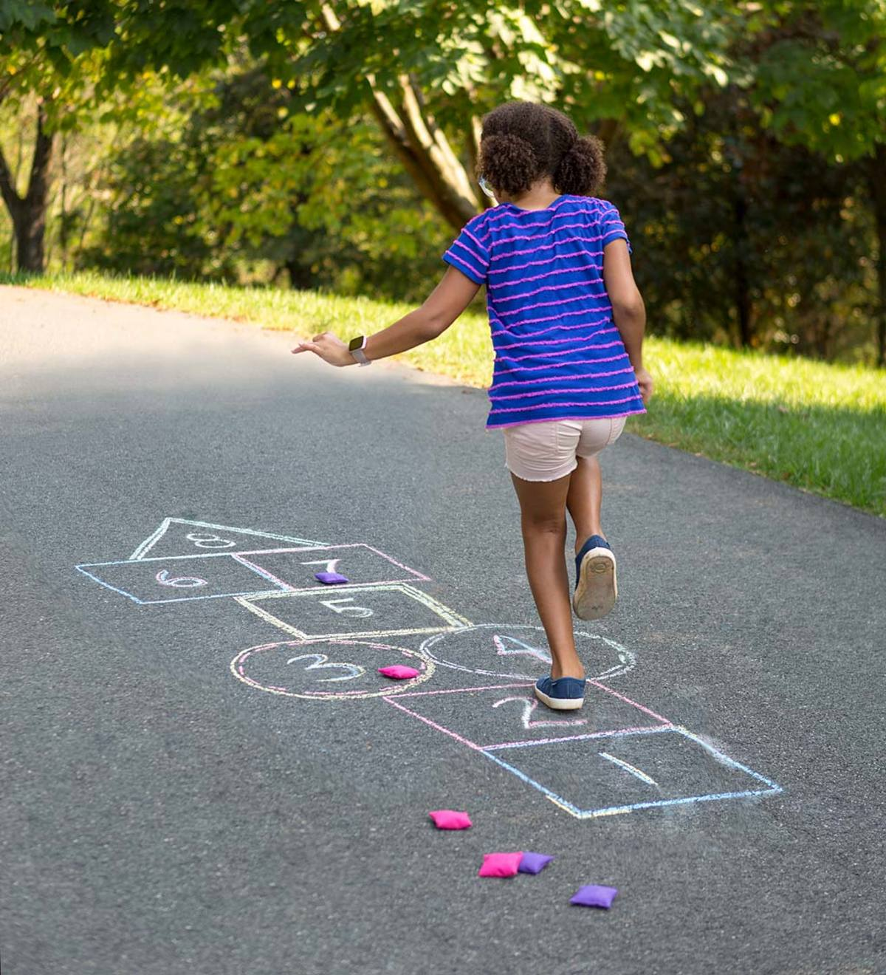
Hopscotch

Slide 8
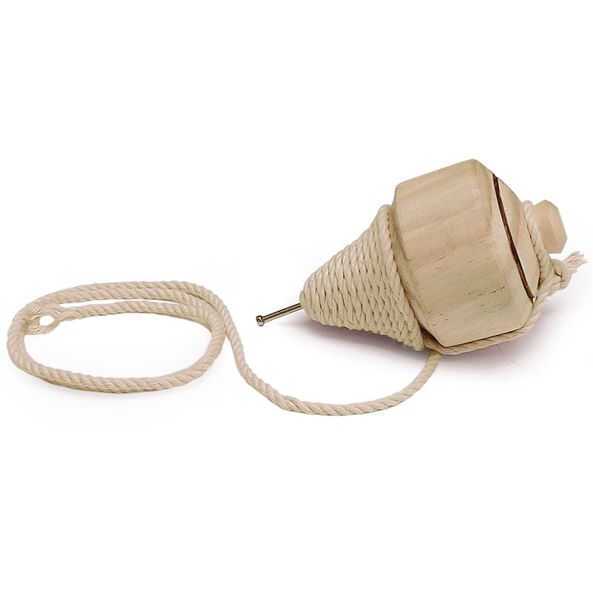
Spinning top

Slide 9
Kites

Slide 10
