Slide 1
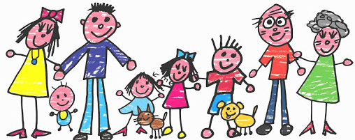

My Family

Slide 2

Mummyy,

Slide 3


Daddyy,

Slide 4


Brothery,

Slide 5


Sistery,

Slide 6
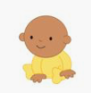
Babyy,

Slide 7

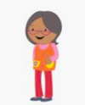
Grannyy,

Slide 8

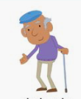
Grandady,

Slide 9

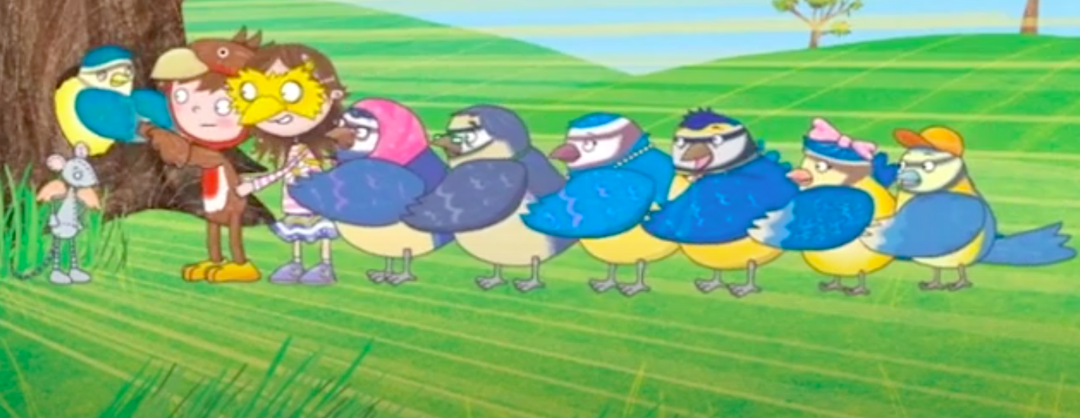

Slide 10
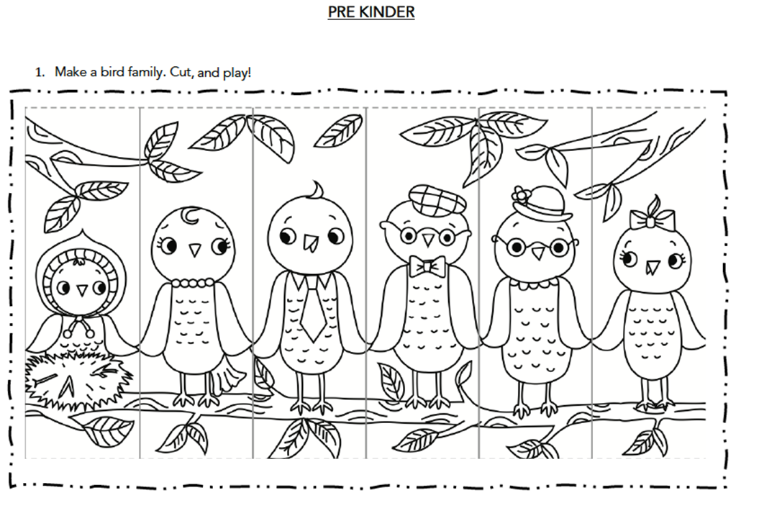

Slide 11

Let’s sing
https://www.youtube.com/watch?v=XqZsoesa55w

Slide 12
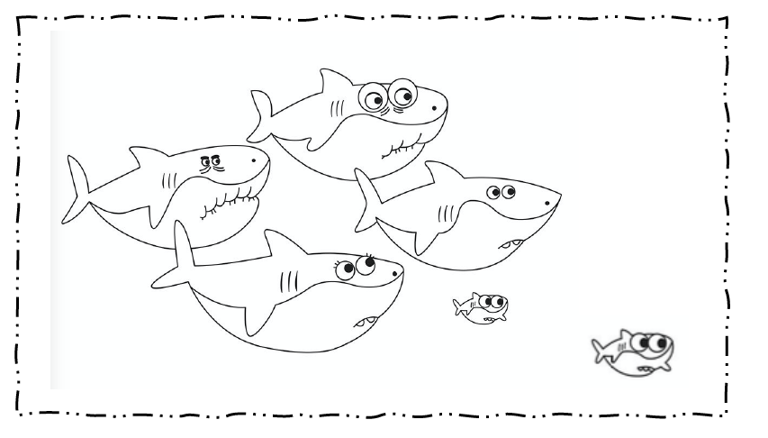
Colour the shark family

