Slide 1
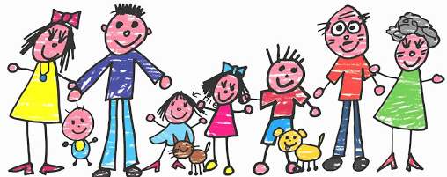
My Family

Slide 2
Mummyy,

Slide 3
Daddyy,

Slide 4
Brothery,

Slide 5
Sistery,

Slide 6
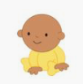
Babyy,

Slide 7
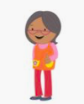
Grannyy,

Slide 8
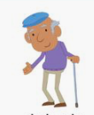
Grandady,

Slide 9
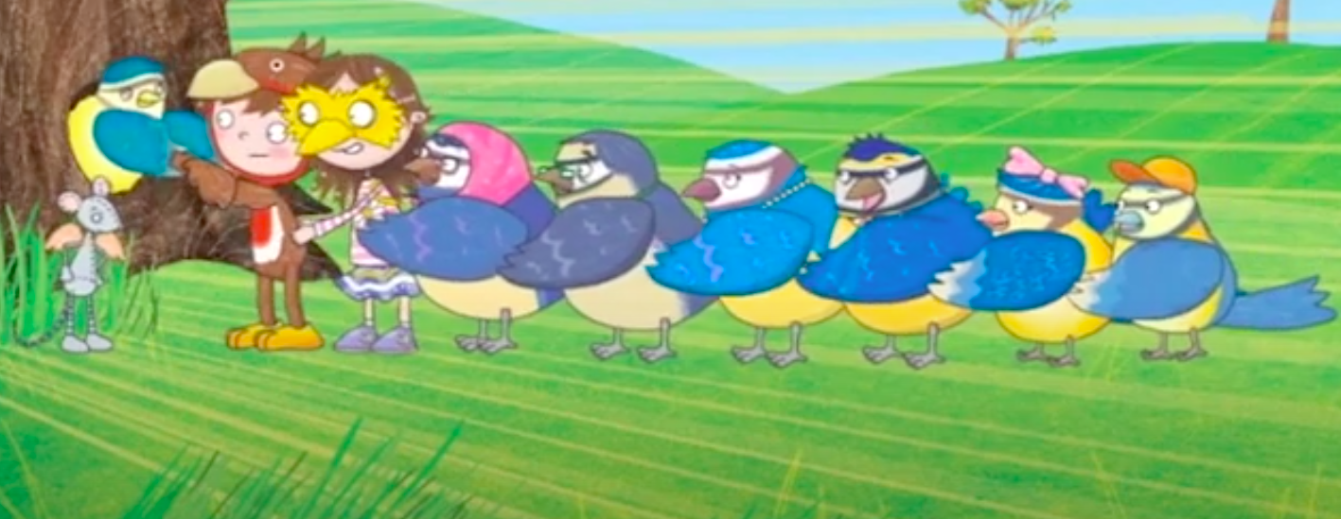

Slide 10
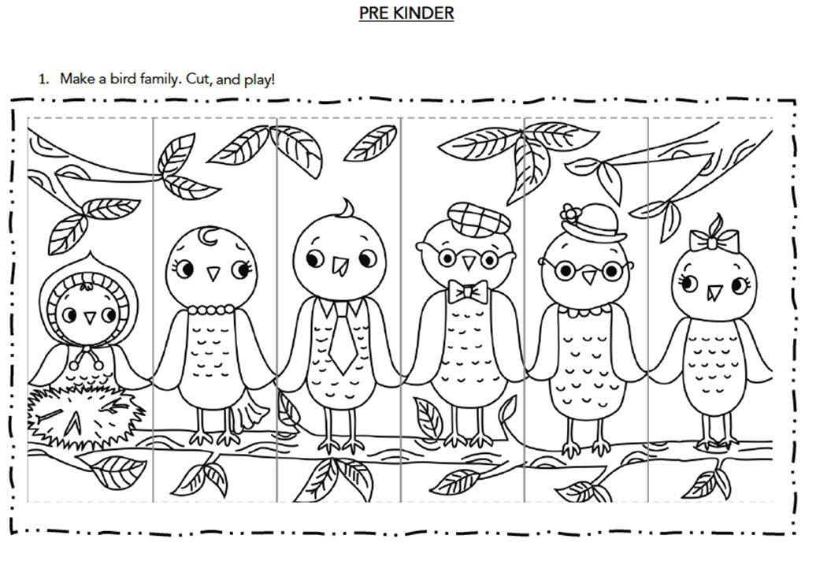

Slide 11
Let’s sing
https://www.youtube.com/watch?v=XqZsoesa55w

Slide 12
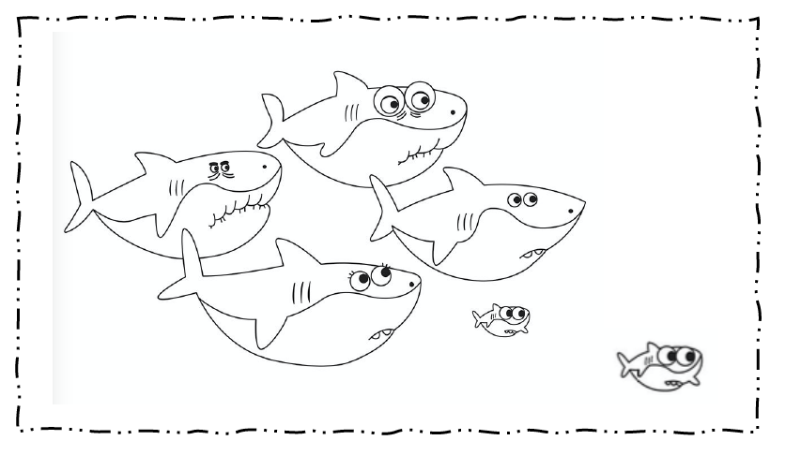
Colour the shark family

